Slide 1
Data Mining
Week4 Lecture 2 Part1
Evaluation Metrics
By Eesha Tur Razia Babar

Slide 2
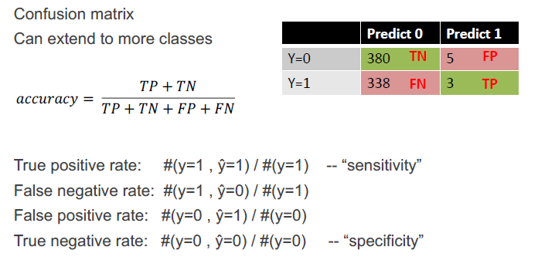
Confusion Matrix

Slide 3
Evaluation Metrics
True positive (TP) or f++, which corresponds to the number of positive
examples correctly predicted by the classification model.
False negative (FN) or f+−, which corresponds to the number of positive
examples wrongly predicted as negative by the classification model.
False positive (FP) or f−+, which corresponds to the number of negative
examples wrongly predicted as positive by the classification model.
True negative (TN) or f−−, which corresponds to the number of negative
examples correctly predicted by the classification model.

Slide 4
Sensitivity and Specificity
The counts in a confusion matrix can also be expressed in terms of percentages.
The true positive rate (TPR) or sensitivity is defined as the fraction of
positive examples predicted correctly by the model, i.e.,
TPR = TP/(TP + FN).
Similarly, the true negative rate (TNR) or specificity is defined as the
fraction of negative examples predicted correctly by the model, i.e.,
TNR = TN/(TN + FP).
Notes:
Sensitivity refers to a test's ability to designate an individual with disease as positive. A highly sensitive test means that there are few false negative results, and thus fewer cases of disease are missed. The specificity of a test is its ability to designate an individual who does not have a disease as negative.

Slide 5
FPR,FNR
Finally, the false positive rate (FPR) is the fraction of negative examples predicted as a positive class, i.e.,
FPR = FP/(TN + FP)
while the false negative rate (FNR) is the fraction of positive examples predicted as a negative class, i.e.,
FNR = FN/(TP + FN)

Slide 6
Precision
Recall and precision are two widely used metrics employed in applications where successful detection of one of the classes is considered more significant than detection of the other classes. A formal definition of these metrics is given below.
Precision, p = TP/(TP + FP)

Slide 7
Recall
Recall measures the fraction of positive examples correctly predicted by the classifier. Classifiers with large recall have very few positive examples misclassified as the negative class. In fact, the value of recall is equivalent to the true positive rate.
Recall, r = TP/(TP + FN)
Notes:
It is often possible to construct baseline models that maximize one metric
but not the other. For example, a model that declares every record to be the
positive class will have a perfect recall, but very poor precision. Conversely,
a model that assigns a positive class to every test record that matches one of
the positive records in the training set has very high precision, but low recall.
Building a model that maximizes both precision and recall is the key challenge
of classification algorithms.

Slide 8
Precision Vs Recall
There’s a trade-off between precision and recall, i.e., one comes at the cost of another. Trying to increase precision lowers recall and vice-versa.
With precision, we try to make sure that what we are classifying as the positive class is a positive class sample indeed, which in turn reduces recall. With recall, we are trying not to miss out on any positive class samples, which allows many false positives to creep in, thus reducing precision.

Slide 9
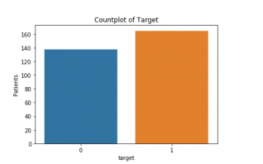
Example

Slide 10
Precision
Precision is the ratio between the True Positives and all the Positives. For our problem statement, that would be the measure of patients that we correctly identify as having a heart disease out of all the patients actually having it.
Precision also gives us a measure of the relevant data points. It is important that we don’t start treating a patient who actually doesn’t have a heart ailment but our model predicted it as having it.

Slide 11
Recall
The recall is the measure of our model correctly identifying True Positives. Thus, for all the patients who actually have heart disease, recall tells us how many we correctly identified as having a heart disease
We refer to it as Sensitivity or True Positive Rate. What if a patient has heart disease, but no treatment is given to him/her because our model predicted so? That is a situation we would like to avoid!

Slide 12
Trade-off
Ideally, for our model, we would like to avoid any situations where the patient has heart disease completely, but our model classifies as him not having it, i.e., aim for high recall.
On the other hand, for the cases where the patient is not suffering from heart disease and our model predicts the opposite, we would also like to avoid treating a patient with no heart disease (crucial when the input parameters could indicate a different ailment, but we end up treating him/her for a heart ailment).

Slide 13
F1 Score
Precision and recall can be summarized into another metric known as the
F1 measure.
F1 = 2rp/r + p
= 2 × TP/2 × TP + FP + FN
The harmonic mean of two numbers x and y tends to be closer to the smaller of the two numbers. Hence, a high value of the F1 measure ensures that both precision and recall are reasonably high

Slide 14
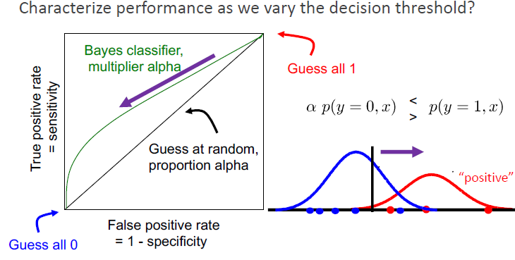
The Receiver Operating Characteristic Curve

